Slide 1
Exception Handling in Java

Slide 2
The Exception Handling in Java is one of the powerful mechanism to handle the runtime errors so that the normal flow of the application can be maintained.
The core advantage of exception handling is to maintain the normal flow of the application.
The java.lang.Throwable class is the root class of Java Exception hierarchy inherited by two subclasses: Exception and Error.
There are mainly two types of exceptions:
checked
unchecked

Slide 3
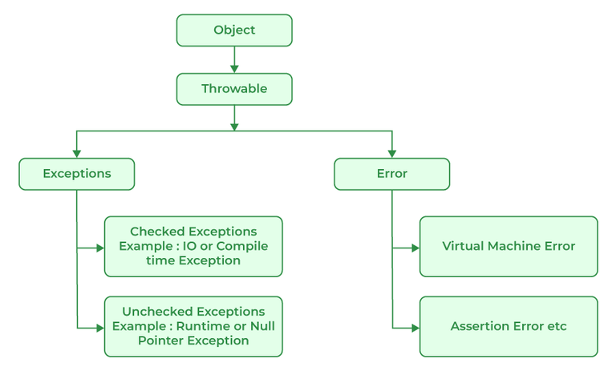
Exception Hierarchy

Slide 4
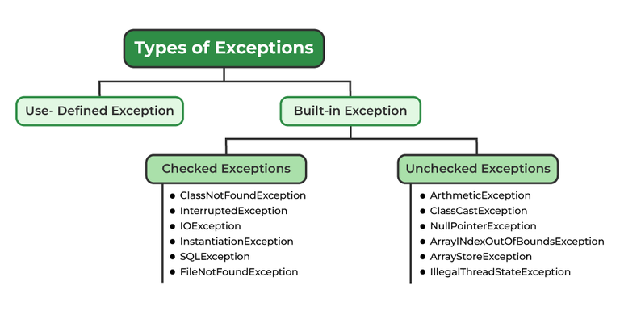
Types of Exceptions

Slide 5
Checked exceptions are checked at compile-time. Such as IOException, SQLException etc.
Unchecked exceptions are not checked at compile-time, but they are checked at runtime. Such as ArithmeticException, NullPointerException, ArrayIndexOutOfBoundsException, etc.

Slide 6
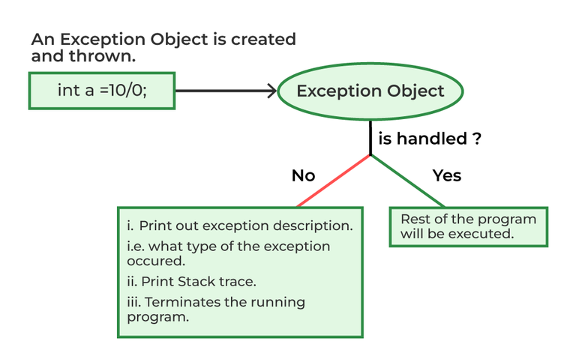
How Does JVM Handle an Exception?

Slide 7
Whenever inside a method, if an exception has occurred, the method creates an Object known as an Exception Object and hands it off to the run-time system(JVM).
Creating the Exception Object and handling it in the run-time system is called throwing an Exception.
There might be a list of the methods that had been called to get to the method where an exception occurred. This ordered list of methods is called Call Stack.
The run-time system searches the call stack to find the method that contains a block of code that can handle the occurred exception. The block of the code is called an Exception handler.

Slide 8
The run-time system starts searching from the method in which the exception occurred and proceeds through the call stack in the reverse order in which methods were called.
If it finds an appropriate handler, then it passes the occurred exception to it. An appropriate handler means the type of exception object thrown matches the type of exception object it can handle.
If the run-time system searches all the methods on the call stack and couldn’t have found the appropriate handler, then the run-time system handover the Exception Object to the default exception handler, which is part of the run-time system.

Slide 9
Exception Keywords
Java provides five keywords that are used to handle the exception
try - place an exception code
catch - handle the exception
finally - execute the necessary code
throw - throw an exception
throws - declare exceptions

